Slide 1

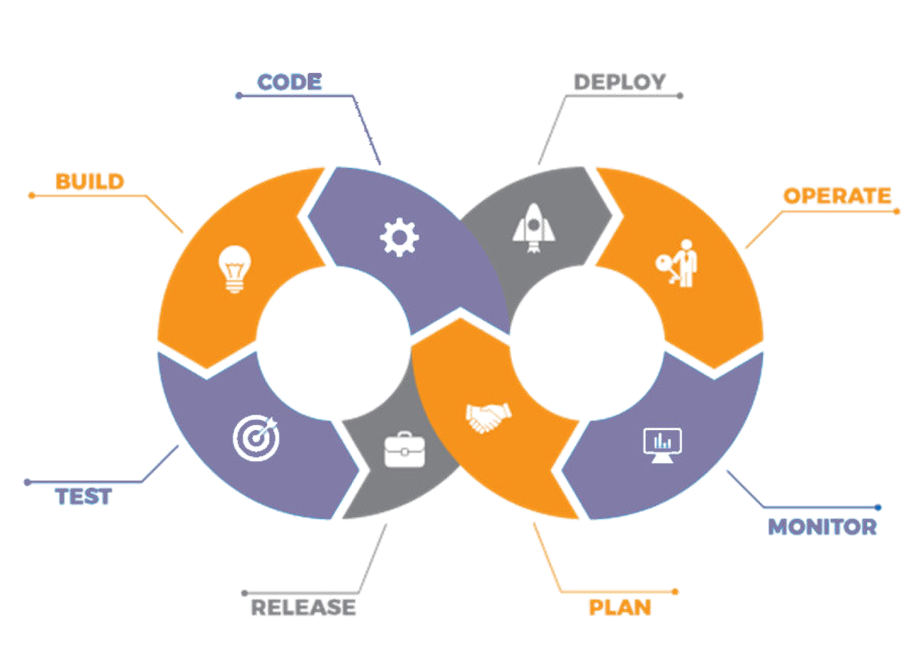
Introduction to Terraform

Slide 2
Agenda
01
What is Infrastructure as a Code?
02
Infrastructure as a Code vs Configuration Management
03
Introduction to Terraform
04
Installing Terraform on AWS EC2
05
Basic Terraform Operations
06
Terraform Code Basics
07
Deploying an end to end Architecture using Terraform

Slide 3
What is Infrastructure as a Code?

Slide 4

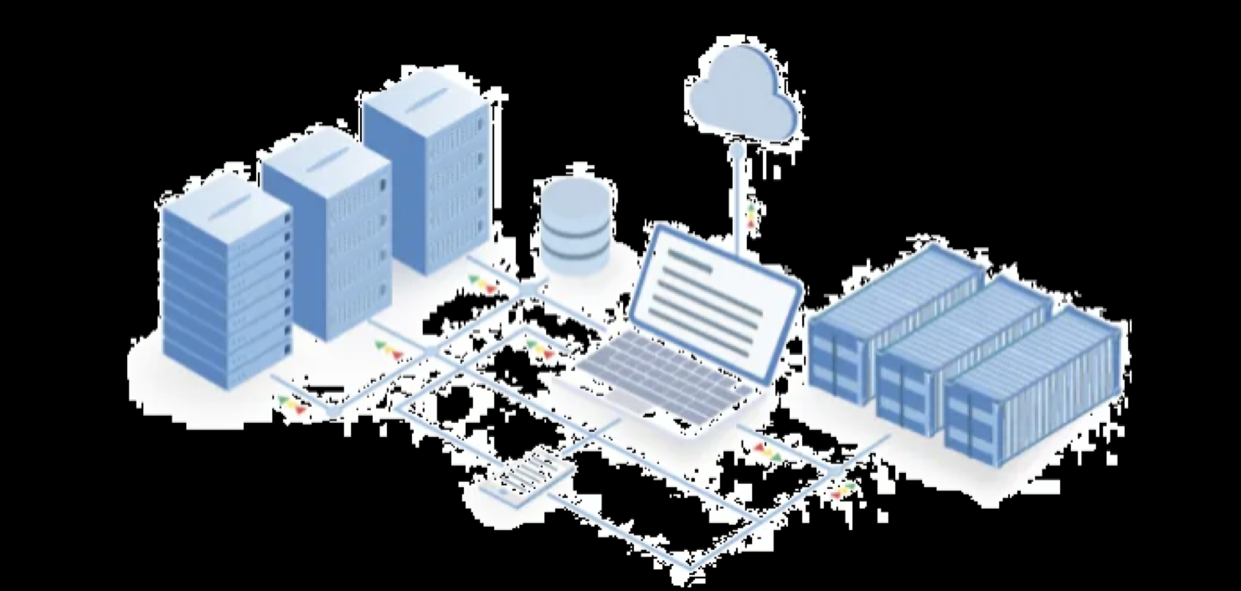
What is Infrastructure as Code (IaC)?
Infrastructure as Code (IaC) is the management of infrastructure (networks, virtual machines, load balancers, and connection topology) in a descriptive model, using the same versioning as DevOps team uses for source code. Infrastructure as Code evolved to solve the problem of environment drift in the release pipeline.

Slide 5
Infrastructure as Code vs Configuration Management

Slide 6





IaC vs Configuration Management
Infrastructure as a Code
Configuration Management
Can create / destroy hardware architectures
Can install software while bootstrapping servers
Should not be used as a replacement to CM tools
Works only with softwares
Cannot work on hardware level, but can install any software
Cannot be used as a replacement to IaC tools

Slide 7
Introduction to Terraform

Slide 8
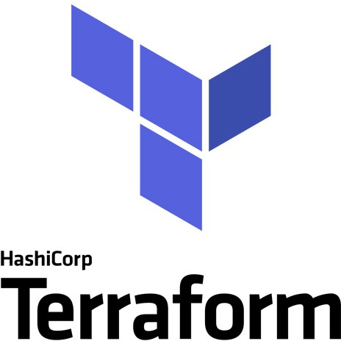
What is Infrastructure as Code (IaC)?
Terraform is an open-source infrastructure as code software tool created by HashiCorp. It enables users to define and provision a datacenter infrastructure using a high-level configuration language known as Hashicorp Configuration Language, or optionally JSON.

Slide 9
Installing Terraform for AWS

Slide 10
Installing Terraform for AWS
Install Terraform on local/EC2 Machine
Create a user, and use this user to authenticate terraform to AWS
Initialize Terraform Directory

Slide 11
Basic Terraform Operations

Slide 12
















Basic Terraform Operations
There are four kinds of operations in Terraform:
Init
Plan
Apply
Destroy

Slide 13
Terraform Code Basics

Slide 14
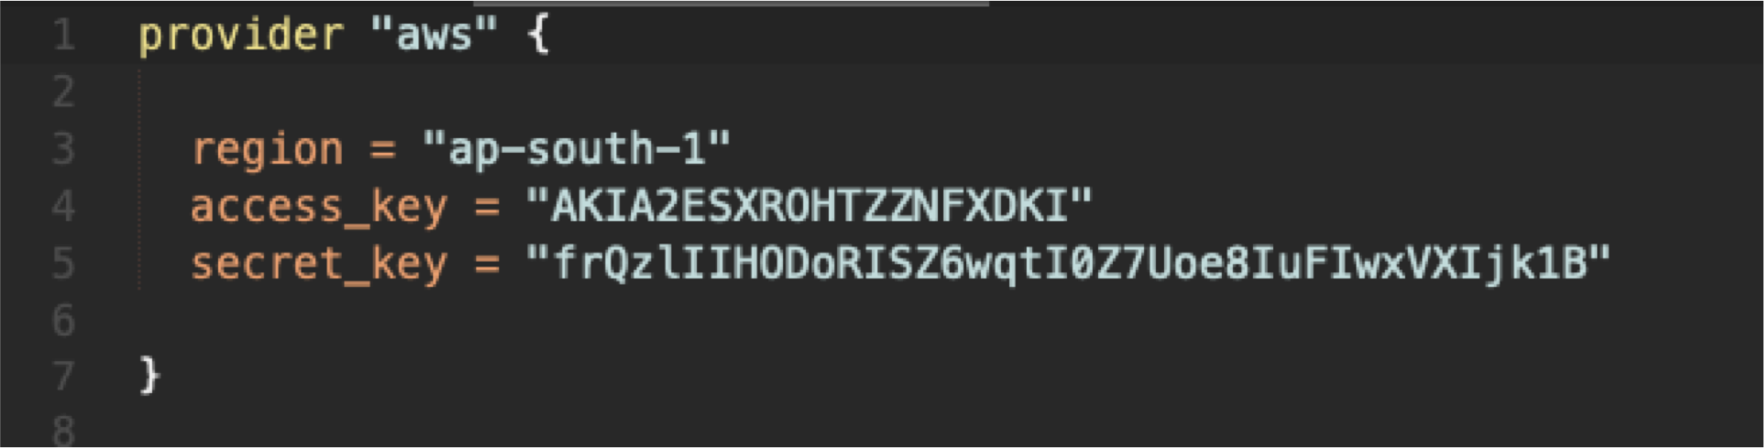
Terraform Code Basics
Following is a snipped of terraform file. Terraform files are saved with the extension of tf (*.tf). It has two main components, block type and Key Value Pairs
Block Type
Key Value Pairs

Slide 15
Deploying end to end Infrastructure using Terraform

